Slide 2
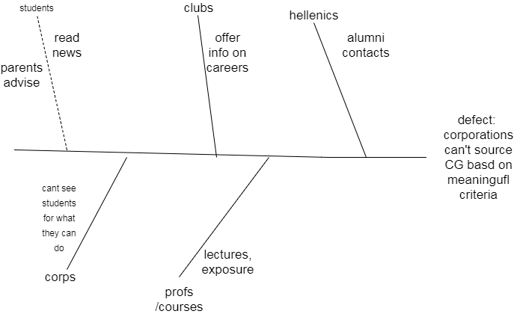
Mission: counteract, solve the defect, attack the root causes of a defect
Form the mission out of the root causes:
Enhance the visibility of students and corporations so they can recruit each other
Connect student talents to the corporations who need them
Inform students on corporations who might need them, based on their strengths
Empower clubs to become beacons of recruitment for corporations
Let the root cause of the defect become the mission for the company
Use the outcomes of the ishikawa to become the mission, in the BMM

Slide 3
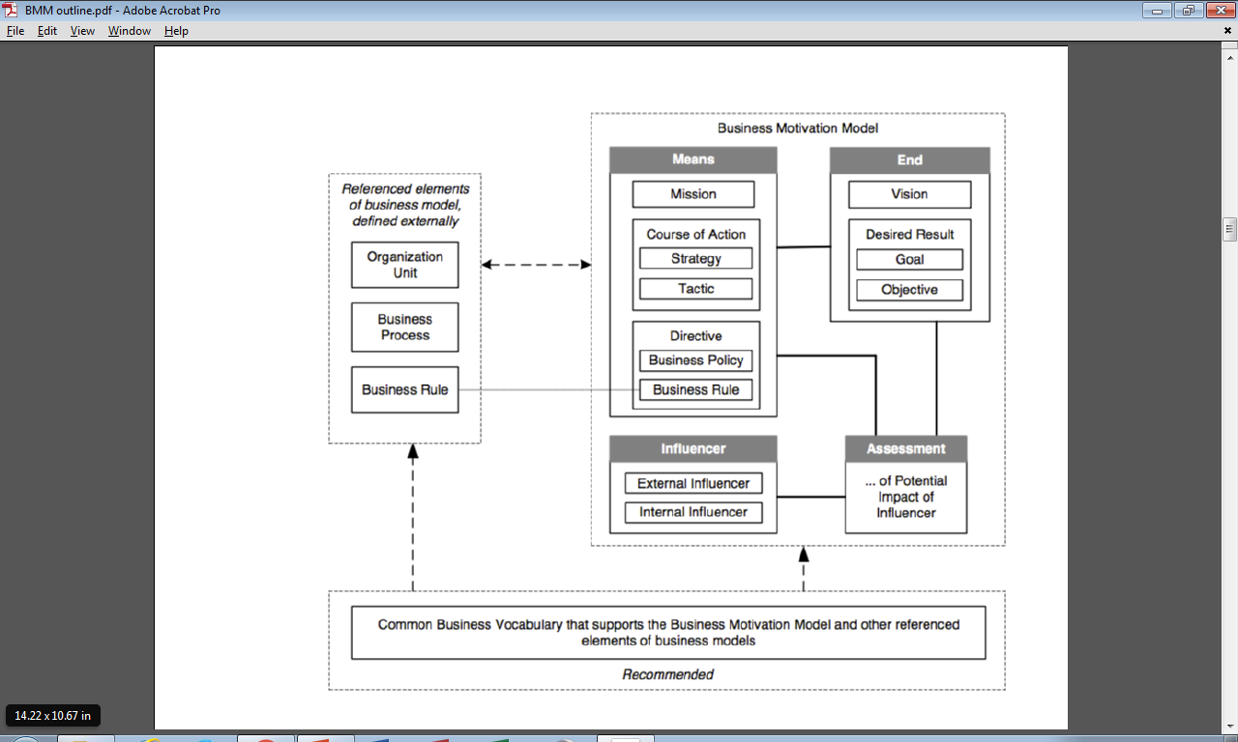
Establish a mission, first step vision(s) should follow

